Slide 1



Study of demand prediction using clustering methods
Application to the consumption of medications in hospitals
Presentation to KLS, September 7 2023

Slide 2

Summary
1
Context and methodology (5 minutes)
2
Clustering (5 minutes)
3
Forecasting (5 minutes)
4
Conclusion (5 minutes)
Author: Douglas MACHADO
Supervisors: Gülgün ALPAN | Zakaria YAHOUNI

Slide 3
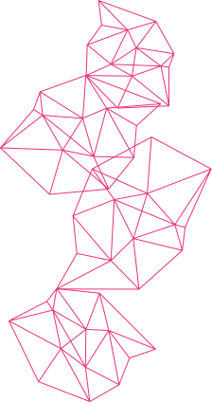

1: Context and Methodology
Pre-processing on products
Traceable drug database
Cross reference 1
Cross reference 2
Structured database
Products database
External drug database
Data extractions
Historical database
Hospital WEB site
Medical unit
database
Medical unit or medical department
1
Notes:
Ok, put database information such as number of medicines and hospitals
show an sample of the data

Slide 4
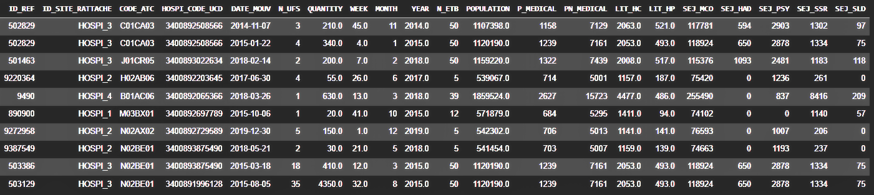
1: Context and Methodology
The main objective of the present research is to identify similarities among various medications, thereby reducing the number of required models for forecasting hospital demand and optimizing stock resource management.
Studying 21 medications across 4 different hospitals, we have a dataset comprising 75,684 data points with 21 features.
The distribution of data points among hospitals is as follows:
Hospital 1: 22, 725 | Hospital 2: 15, 439 Hospital 3: 27, 591 | Hospital 4: 9, 929
2
Notes:
Ok, put database information such as number of medicines and hospitals
show an sample of the data

Slide 5
1: Context and Methodology
Structured databased
4: Clustering
1: Database formatting
2: Data treatment
5: Forecasting
3: Feature manipulation and comprehension
Daa treatment
3
Notes:
Put a slied for objective and context before methodology

Slide 6
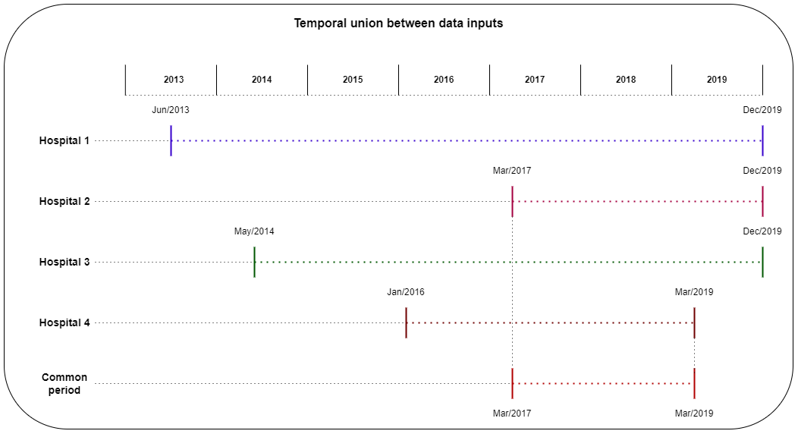
1: Database formatting
2: Data treatment
3: Feature manipulation and comprehension
4: Clustering
5: Forecasting
1: Context and Methodology
2: Data treatment
Remove outliers and address missing data.
Group data by month, year, UCD code, and hospital.
Understand and manage the gaps for the different hospitals.
For the time series approach, a common data period was chosen for all hospitals.
4

Slide 7
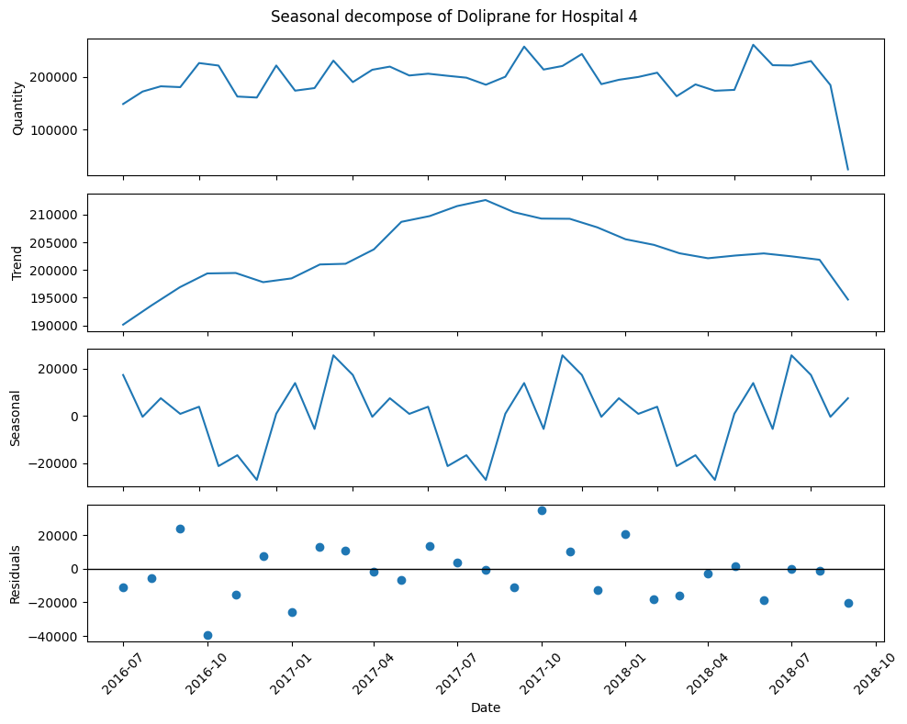
1: Database formatting
2: Data treatment
3: Feature manipulation and comprehension
4: Clustering
5: Forecasting
1: Context and Methodology
3: Feature manipulation and comprehension
Seasonal decomposition.
Calculation of the moving average.
Principal Component Analysis (PCA) was tested but did not yield useful information.
Trends in consumption, seasonality, and residuals were used as features to group different medicines.
5

Slide 8
1: Database formatting
2: Data treatment
3: Feature manipulation and comprehension
4: Clustering
5: Forecasting
2: Clustering
k-means clustering
Regroupement
mini-batch k-means
4: Clustering
agglomerative clustering
manual clustering
6
Notes:
Create backup slides explaining the clustering techniques individually

Slide 9
1: Database formatting
2: Data treatment
3: Feature manipulation and comprehension
4: Clustering
5: Forecasting
2: Clustering
The raw dataset contains information about various medicines and different hospitals.
Because of the limited amount of data, the research is concentrated on the unified approach.
Hospital 1
Hospital 2
Hospital 1
Hospital 2
Hospital 3
Hospital 4
Hospital 3
Hospital 4
Unified approach
Division approach
7
Notes:
TWO APPROACHES : DIVISION AND UNIFIED

Slide 10
1: Database formatting
2: Data treatment
3: Feature manipulation and comprehension
4: Clustering
5: Forecasting
2: Clustering
Time series
Various time series are available for each medicine and hospital, taking into account the seasonal decomposition features (trend, seasonality, and residuals).
Hospital 1
Hospital 2
Hospital 3
Causal method
Hospital 4
All data from different periods, regardless of time factors and seasonality, were considered, taking into account the 21 features presented earlier.
Unified approach
After grouping the data as presented in the data treatment step, there was an average of 50 data points for each combination of hospital and medicine. The minimum was 8 data points, and the maximum was 68.
8
Notes:
TIME SERIES AND CAUSAL

Slide 11
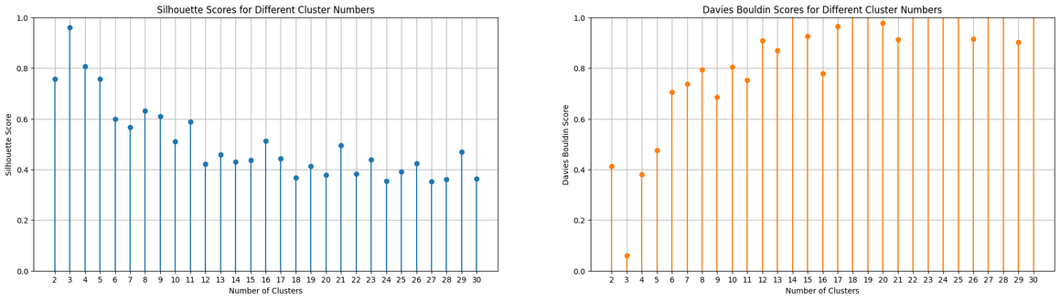
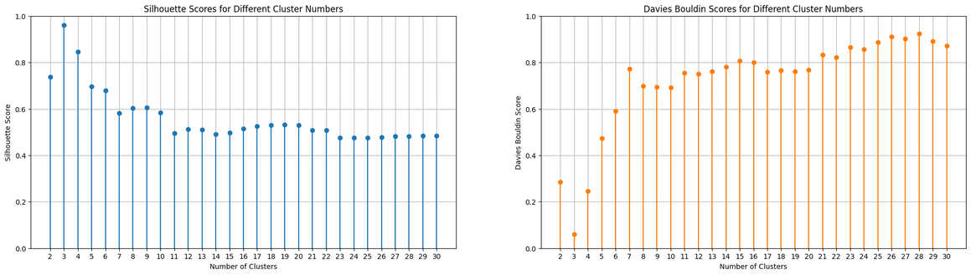
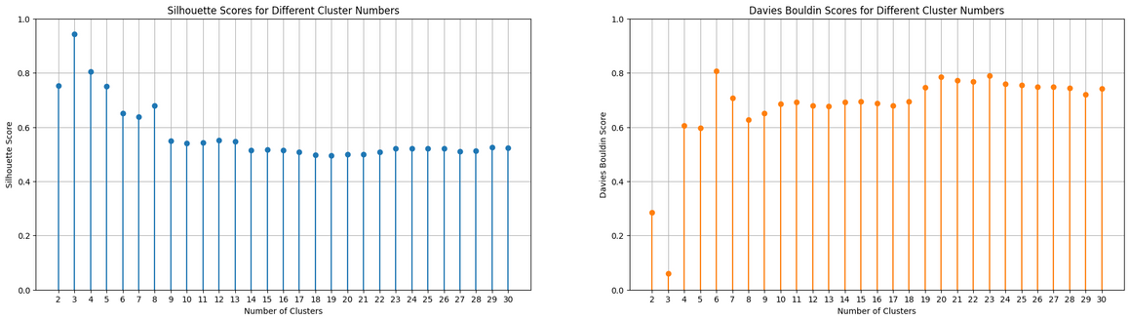
1: Database formatting
2: Data treatment
3: Feature manipulation and comprehension
4: Clustering
5: Forecasting
2: Clustering
mini-batch k-means
Regarding the silhouette metric, all three different clustering methods yielded their maximum score when using 3 clusters.
k-means clustering
agglomerative clustering
9
Notes:
add results and remove first figure

Slide 12
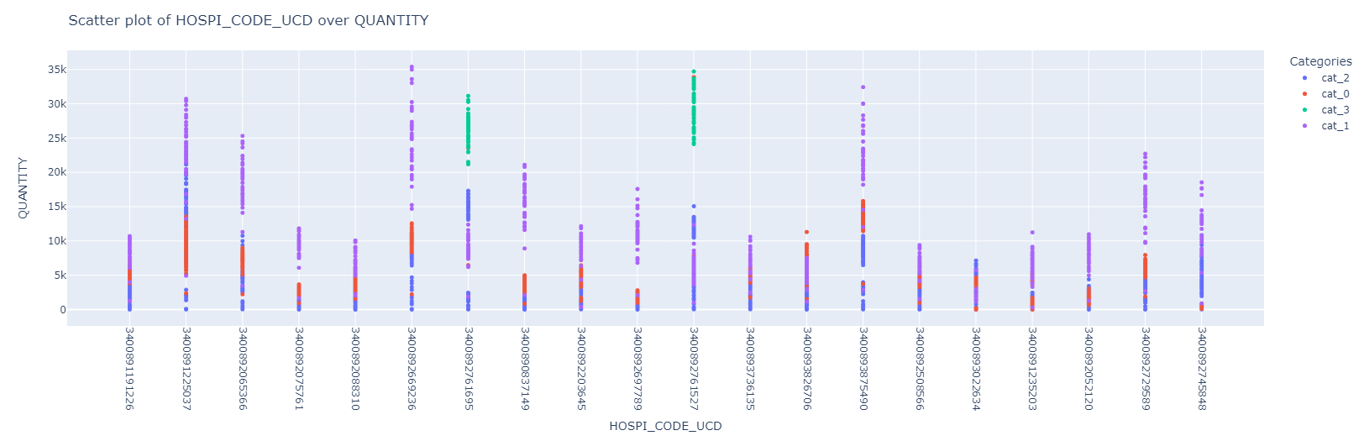
1: Database formatting
2: Data treatment
3: Feature manipulation and comprehension
4: Clustering
5: Forecasting
2: Clustering
All medicines were placed in separate clusters.
There is an issue concerning the distribution of data points in each cluster.
This problem becomes more pronounced in subsequent sections where there is less data available for training models.
The quantity factor plays a predominant role in the clustering decisions.
10

Slide 13
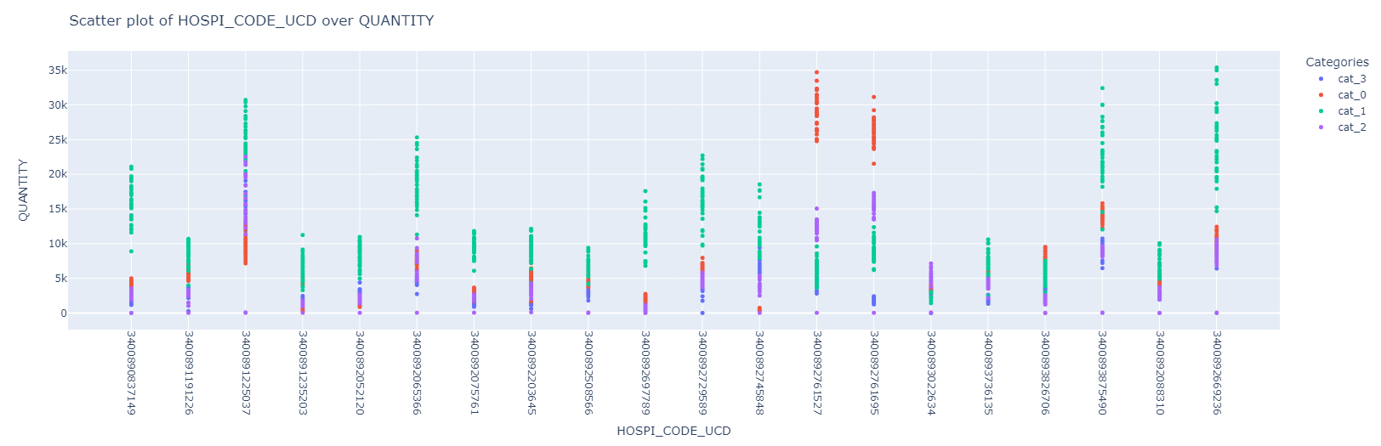
1: Database formatting
2: Data treatment
3: Feature manipulation and comprehension
4: Clustering
5: Forecasting
2: Clustering
Time series
The time series approach, which exclusively utilized features related to quantity, produced a comparable result to the clustering approach. Each medicine appears to be included in more than one cluster.
However, a significant challenge remains, particularly for medicines with minimal data points. This limitation could have a negative impact on the forecasting models.
11

Slide 14
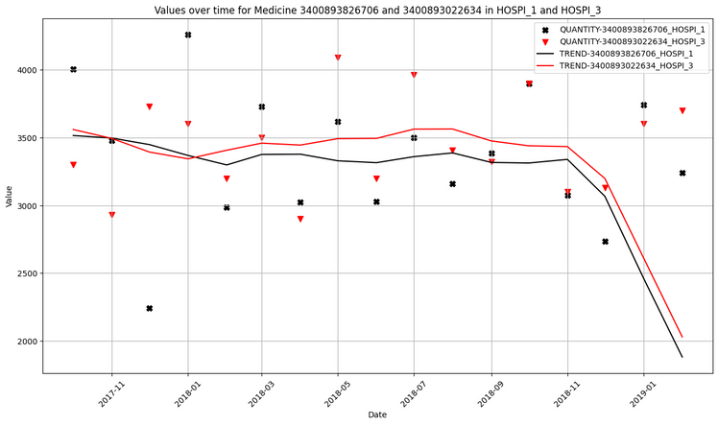
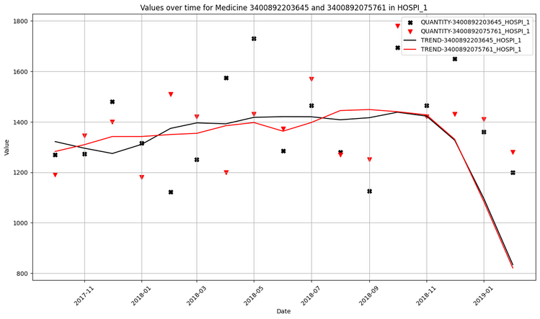
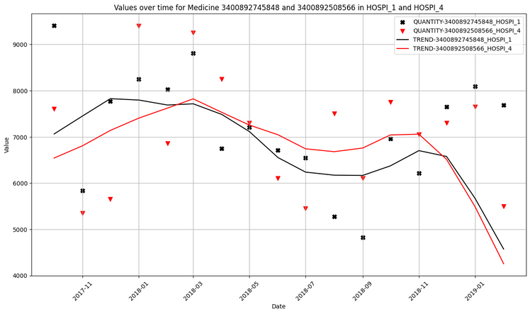
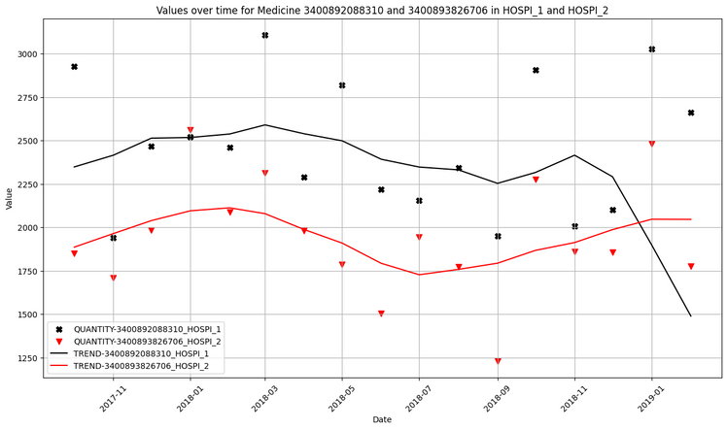
1: Database formatting
2: Data treatment
3: Feature manipulation and comprehension
4: Clustering
5: Forecasting
2: Clustering
Manual clustering was performed on pairs of medicines.
The pairs consisted of combinations of hospitals and medicines.
These pairs were grouped based on similarities in trend.
12

Slide 15
1: Database formatting
2: Data treatment
3: Feature manipulation and comprehension
4: Clustering
5: Forecasting
3: Forecasting
5: Forecasting
Random forest regressor
Baseline
Prévision
Clusters with causal method
Clusters with Time series
Forecasting with Manual clusters
13

Slide 16
1: Database formatting
2: Data treatment
3: Feature manipulation and comprehension
4: Clustering
5: Forecasting
3: Forecasting
The primary objective of this research is to identify similarities among different medicines, ultimately reducing the number of models required for forecasting hospital demand, thus optimizing stock resources.
The research is divided into two main streams: the causal and time series approaches. Additionally, it is categorized into the unified and division approaches. However, the unified approach proves to be more suitable for addressing the current problem.
Based on the work of D. KOALA, the random forest regressor outperforms other tested models in the current context.
To establish performance benchmarks for the new models, a baseline must be calculated for the tested methodologies.
14
Notes:
REMIND THE OBJECTIVE OF THIS STEP ; WHY WE NEED BASELINE ?

Slide 17
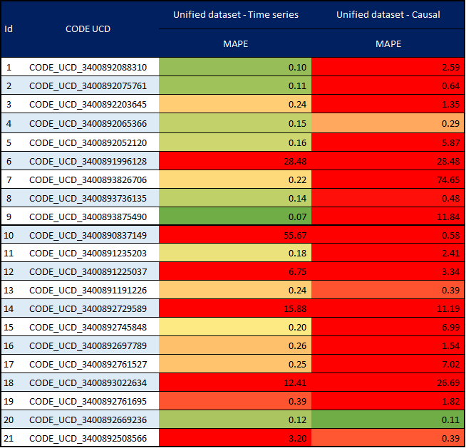
1: Database formatting
2: Data treatment
3: Feature manipulation and comprehension
4: Clustering
5: Forecasting
3: Forecasting
Considering the practical requirements of the current project, the Mean Absolute Percentage Error (MAPE) metric was chosen to assess the quality of each model.
A separate model was developed for each medicine, utilizing data from all four hospitals.
It is observed that the time series approach outperforms the causal approach in terms of model performance.
These results can be attributed to variations in dataset composition between the two approaches and specific periods in the data that pose challenges for the models.
15

Slide 18
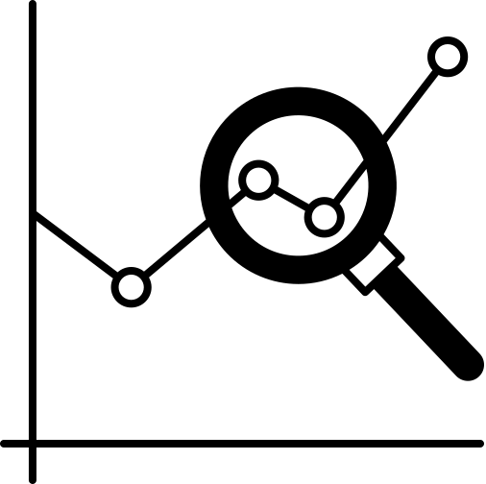
1: Database formatting
2: Data treatment
3: Feature manipulation and comprehension
4: Clustering
5: Forecasting
3: Forecasting
To execute the training of our models, followed by the testing and validation phases, the following policy was implemented:
Train (80%)
Test (20%)
1
Hospital 1
H2
1
2
Hospital 2
Hospital 3
3
Same applied for other clusters
Hospital 4
4
Separate by cluster
Predict and analyze by drug
Unified approach
Clustering
Divide by train test
16
Notes:
EXPLAIN THE TRAIN / TEST STEPS FOR A CLUSTER OF MEDECINES

Slide 19
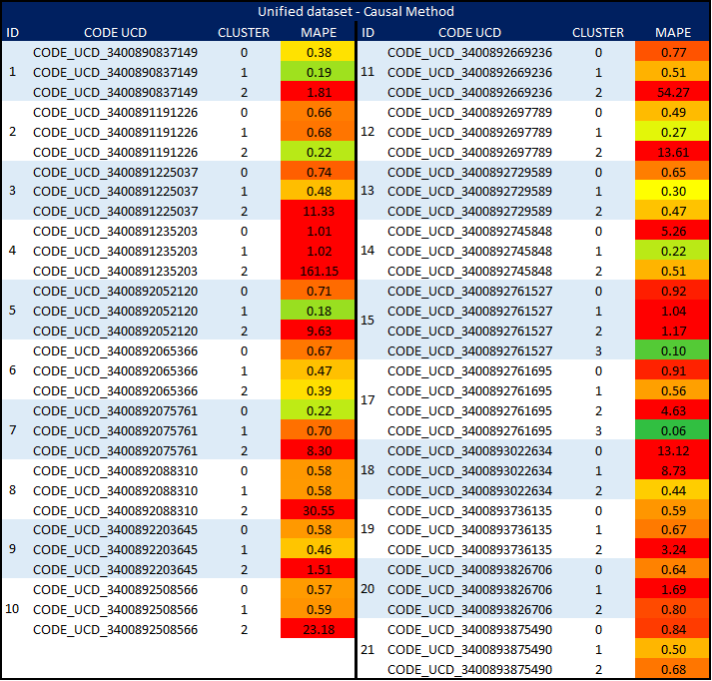
1: Database formatting
2: Data treatment
3: Feature manipulation and comprehension
4: Clustering
5: Forecasting
3: Forecasting
The utilization of clustering to group different medicines and reduce the number of models has negatively impacted the prediction quality in the causal method.
This outcome can be attributed to the insufficient amount of data and the subdivision of already limited data into even smaller segments.
Some clusters exhibit favorable outcomes, but it's notable that different medicines within the same cluster do not yield positive results, exemplified by Cluster 1.
17
Notes:
explain the process of MAPE with cluster (train - test)

Slide 20
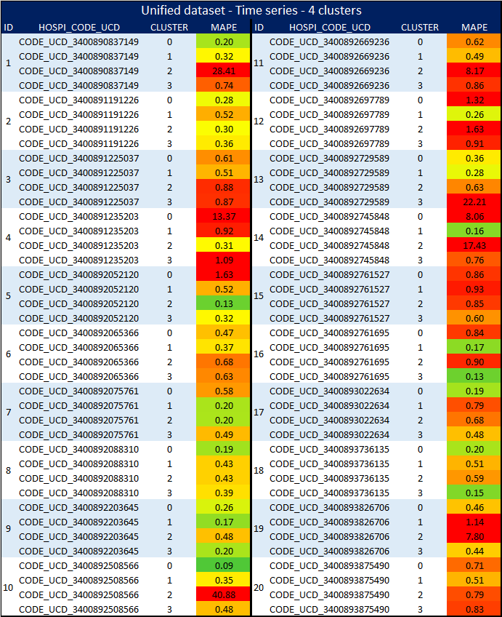
1: Database formatting
2: Data treatment
3: Feature manipulation and comprehension
4: Clustering
5: Forecasting
3: Forecasting
Employing clustering on the time series dataset for forecasting did not yield the anticipated improvement in MAPE scores when compared to the baseline.
While the scores obtained through this approach are superior to those of the causal method, they remain unacceptable due to the unique characteristics of the problem.
18

Slide 21
1: Database formatting
2: Data treatment
3: Feature manipulation and comprehension
4: Clustering
5: Forecasting
3: Forecasting
In general, the results using clustering techniques are not good and can’t replace the techniques of forecasting by medicine
The main hypothesis for the poor results is the lack of data present in the dataset.
Taking, for example, the data points presented in the previous sections where there are 8 registered points that are not zero, if the medicine is split into 4 clusters, the best scenario would be 2 data points for each cluster, the worst, one cluster with 5 data points, and the others with 1, making it impossible to conduct effective training and evaluation tests with the forecasting models.
Taking this into consideration, one way to solve this problem would be to identify similarities in the entire time series, where we could create pairs of medicines and test them together.
1
5
1
5
2
6
2
6
3
7
3
7
4
8
4
8
Worst
Best
Both are not enough
19

Slide 22
1: Database formatting
2: Data treatment
3: Feature manipulation and comprehension
4: Clustering
5: Forecasting
3: Forecasting
5: Forecasting
Random forest regressor
Baseline
Prévision
To recap, we explored various approaches to forecast the demand for medicines in hospitals.
The most recent attempt involves identifying similarities between different time series, each composed of a combination of a medicine and a hospital, to predict the demand for each medicine in these pairs.
As a result of manual clustering, specific pairs were chosen for testing. Data points were split into training and testing sets, and each medicine in the pair was evaluated individually.
Clusters with causal method
Clusters with Time series
Forecasting with Manual clusters
20

Slide 23
1: Database formatting
2: Data treatment
3: Feature manipulation and comprehension
4: Clustering
5: Forecasting
3: Forecasting
5: Forecasting
Random forest regressor
Baseline
Prévision
Clusters with causal method
Clusters with Time series
The selected pairs to test in the forecasting part represent 10% (206) of the total number of possibilities (2310).
Forecasting with Manual clusters
21

Slide 24
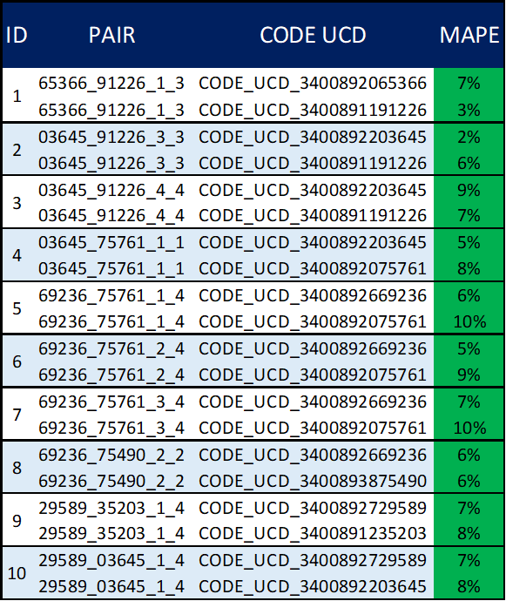
1: Database formatting
2: Data treatment
3: Feature manipulation and comprehension
4: Clustering
5: Forecasting
3: Forecasting
The 10 pairs with the best metrics were selected to illustrate the quality of the forecasting models.
It is evident that some combinations of medicines and hospitals perform better than others.
Some medicines, in different combinations, also perform well, indicating that clusters with more than 2 medicines could be effective.
After testing with 2 medicines, we also tested with 3 or more medicines, but the positive results did not repeat as expected.
A better technique for clustering time series could be applied, such as DTW (Dynamic Time Warping).
22

Slide 25
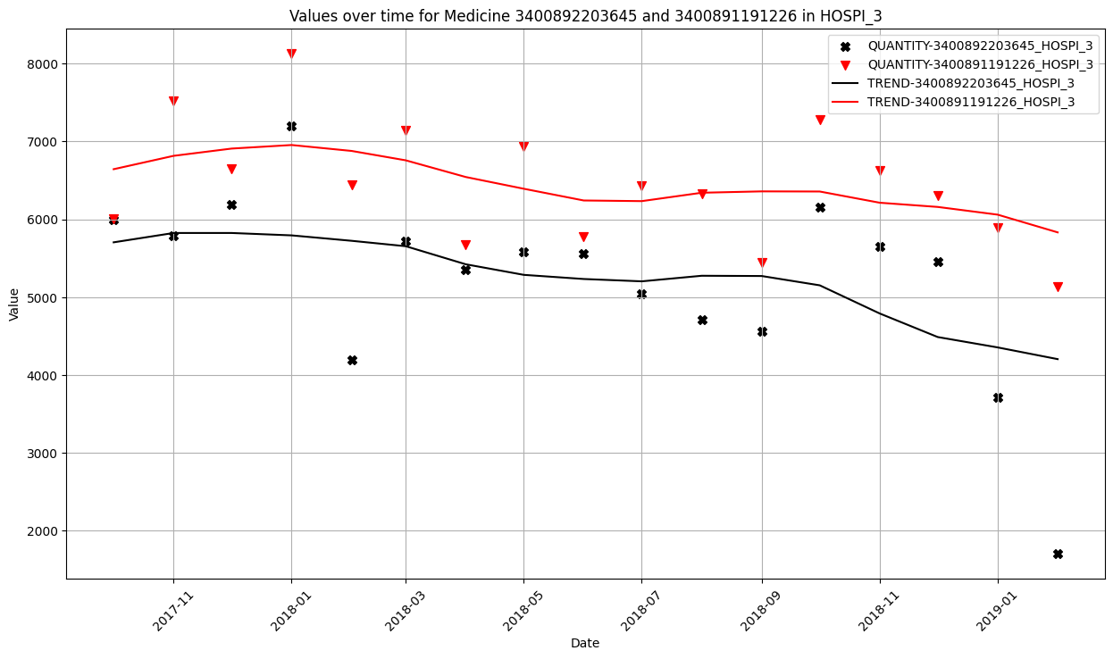
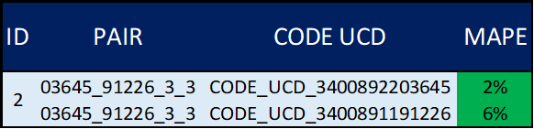
1: Database formatting
2: Data treatment
3: Feature manipulation and comprehension
4: Clustering
5: Forecasting
3: Forecasting
Even with different magnitudes, similarities were still present, which resulted in favorable forecasting evaluations.
23

Slide 26
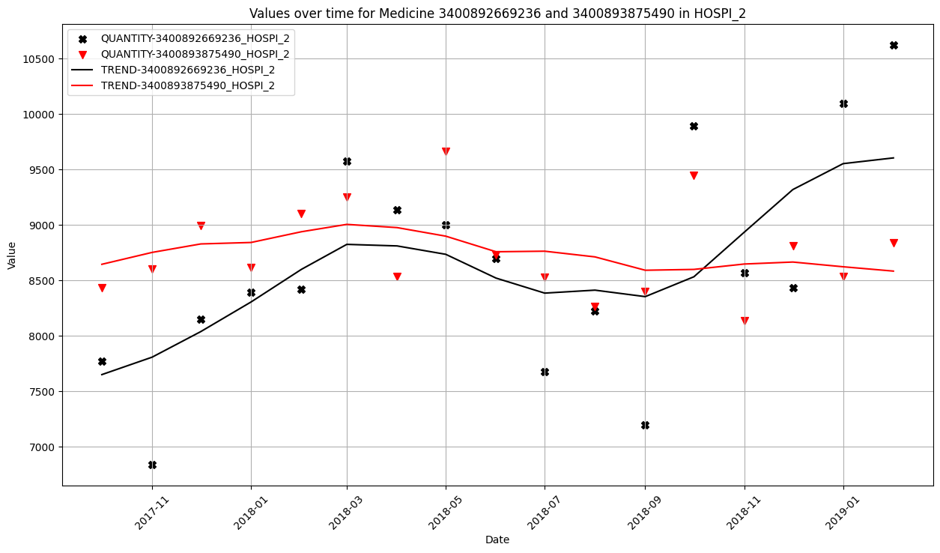
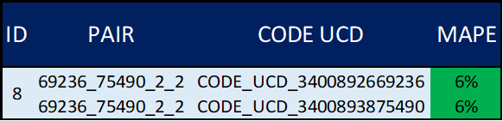
1: Database formatting
2: Data treatment
3: Feature manipulation and comprehension
4: Clustering
5: Forecasting
3: Forecasting
The trends and magnitudes of both series are similar, differing only at the end. However, these similarities were sufficient to produce a prediction with less than a 10% error rate.
24

Slide 27
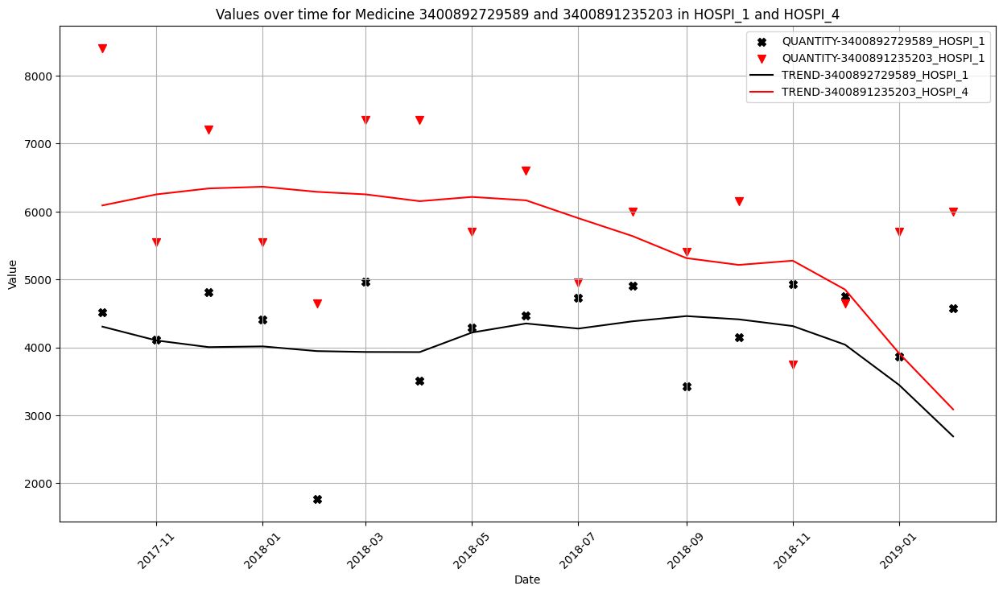
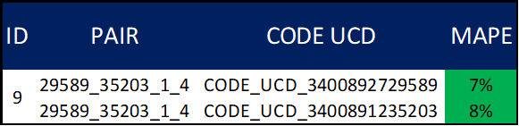
1: Database formatting
2: Data treatment
3: Feature manipulation and comprehension
4: Clustering
5: Forecasting
3: Forecasting
Continuing from the previously observed patterns, this pair exhibits an error rate of less than 10%. Despite differences in magnitude, it produced favorable results in terms of MAPE and outperformed the baseline and other clustering techniques.
25

Slide 28
4: Conclusion
Conventional clustering methods failed to produce satisfactory MAPE metric scores in forecasting tests.
Discrepancies in the data across various hospitals complicated the development of robust models and accurate predictions.
Manual clustering, however, led to favorable forecasting scores.
Certain medicines achieved predictions with errors below 10% in manual clustering.
In manual clustering, specific combinations of medicines and hospitals outperformed the baseline and other clustering techniques.
26

Slide 29
4: Conclusion
It is advisable to explore advanced time series clustering techniques, like Dynamic Time Warping.
Gathering additional data is essential to determine whether the subpar performance of clustering techniques can be mitigated with larger datasets.
Addressing data gaps can be achieved through established methods found in the literature, including extrapolation, SARIMA, or other machine learning approaches.
The current findings should undergo testing through simulations using synthetic data to emulate a new hospital scenario.
27

Slide 30
References
François Hada*. Les sources d’informations et de données sur le médicament. Revue française des affaires sociales, 1(3) :087–098, 2007.
Denis Koala, Zakaria Yahouni, Gülgün Alpan, and Yannick Frein. Factors influencing drug consumption and prediction methods, 2021
Denis Koala, Zakaria Yahouni, Gülgün Alpan, and Djamal Si Mohand. Correlation analysis of factors impacting health product consumption in French hospitals. IFAC-PapersOnLine, 55(10) :895–900, 2022. ISSN 24058963. doi : 10.1016/j.ifacol.2022.09.415.
Denis Koala, Zakaria Yahouni, Gülgün Alpan, and Djamal S I Mohand. Machine learning versus consumption-based models for predicting medicine demand in french hospitals : a case study. -, 2023
Stanley Suan You Lim, Siao-Leu Phouratsamay, Zakaria Yahouni, and Eric Gascard. Medicine consumption demand forecasting in french hospitals using SARIMA model. Master’s thesis, Grenoble INP, 2023.
Wes McKinney, Josef Perktold, and Skipper Seabold. Time series analysis in python with statsmodels. Jarrodmillman Com, pages 96–102, 2011
A.C. Muller and S. Guido. Introduction to Machine Learning with Python : A Guide for Data Scientists. O’Reilly Media, Incorporated, 2018. ISBN 9789352134571. URL https://books.google.fr/books?id=jGdXswEACAAJ.
Meinard Müller. Dynamic time warping. Information retrieval for music and motion, pages 69–84, 2007
28

Slide 31
References
Kevin P. Murphy. Probabilistic Machine Learning : An Introduction. MIT Press, 2022. URL probml.ai.
Tim Oates, Laura Firoiu, and Paul R Cohen. Clustering time series with hidden markov models and dynamic time warping. In Proceedings of the IJCAI-99 workshop on neural, symbolic and reinforcement learning methods for sequence learning, pages 17–21. Citeseer, 1999
OECD. Health at a Glance 2013 : OECD Indicators. OECD Publishing, 2013. URL http://dx.doi.org/10.1787/health_glance-2013-en. DOI : 10.1787/health_glance-2013-en.
F. Pedregosa, G. Varoquaux, A. Gramfort, V. Michel, B. Thirion, O. Grisel, M. Blondel, P. Prettenhofer, R. Weiss, V. Dubourg, J. Vanderplas, A. Passos, D. Cournapeau, M. Brucher, M. Perrot, and E. Duchesnay. Scikit-learn : Machine learning in Python. Journal of Machine Learning Research, 12 : 2825–2830, 2011.
Skipper Seabold and Josef Perktold. statsmodels : Econometric and statistical modeling with python. In 9th Python in Science Conference, 2010.
The pandas development team. pandas-dev/pandas : Pandas. Zenodo, Feb 2020. URL https://doi.org/10.5281/zenodo.3509134
Daniel Vélez, Siao-Leu Phouratsamay, Zakaria Yahouni, and Gülgün Alpan. Predicting medicine demand fluctuations through markov chain. In 12th International Workshop on Service Oriented, Holonic and Multi-Agent Manufacturing Systems for Industry of the Future, pages 329–340, Bucharest, Romania, September 2022. doi : 10.1007/978-3-031-24291-5_26. URL https://hal.archives-ouvertes.fr/hal-03951534.33
29

Slide 32
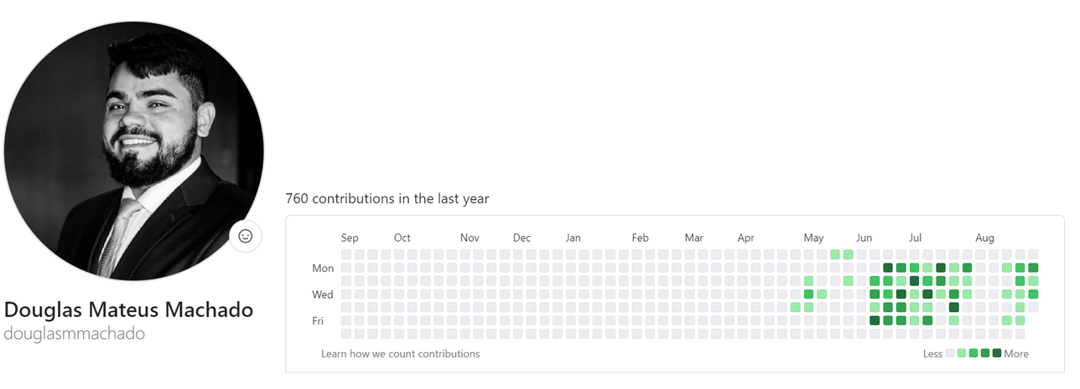






Contact info
douglas.mateus-machado@grenoble-inp.org
+33 07 49 78 00 55
douglas-machado
douglasmmachado

Slide 33


Thanks
Gülgün ALPAN | Zakaria YAHOUNI | Denis KOALA

